Slide 1


Team 70: VFD Motor Controller
Bi-Weekly Update 2
Mackenzie Miller
Andrew Nguyen
Aidan Rader
Ryan Regan Sponsor: John Lusher TA: Ali Alenezi
Notes:
Mackenzie
30 seconds

Slide 2
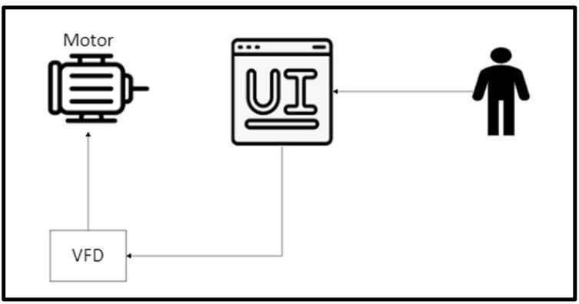
Project Summary
Problem: Traditional motor control systems cannot adjust to varying load demands, resulting in poor energy efficiency, excessive heat generation, and premature component failure
Solution: Develop a Variable Frequency Drive (VFD) motor control system to adjust frequency and voltage to load demands
Notes:
Mackenzie
30 seconds
What is the problem that we are solving
High-level summary of what system does to solve the problem
Picture / Diagram here

Slide 3
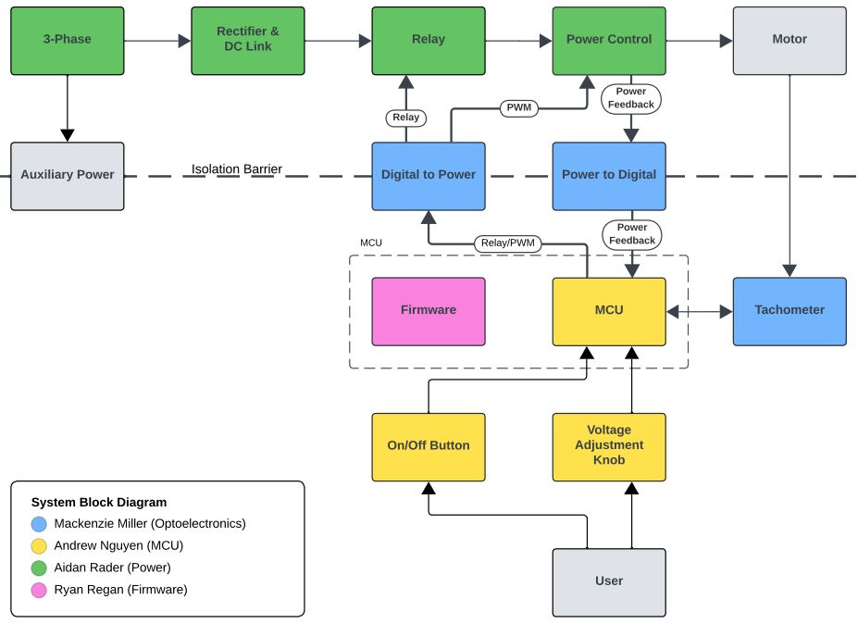
Project/Subsystem Overview
Notes:
Aidan
45 seconds
Diagram showing subsystems – with labels showing subsystem owners

Slide 4
Project Timeline
2/12 | 2/19 | 3/7 | 3/19 | 4/2 | 4/16 | 4/28
Subsystem PCBv1 Design & Testing | Auxiliary Power & MCU/Firmware Integration | PWM Control Integration | System Integration | System Testing | System Validation | Demo, Showcase, & Report
Notes:
Aidan
45 seconds
Diagram showing subsystems – with labels showing subsystem owners

Slide 5
Optoelectronics
Mackenzie Miller
Accomplishments since last update 20 hrs of effort | Ongoing progress/problems and plans until the next presentation
Received PCB board Partially assembled (pending delivery of parts) Basic integration with firmware for PWM control | Fully populate board Retry integration with firmware with new components Begin integration with MCU
Notes:
Mackenzie
45 seconds
What has been accomplished since last review (not just started)
What are you going to accomplish in the next 2 weeks
For 2nd review should all be in the context of your integration plans! For example:
“Completed X-function in preparation for integrating with Y-subsystem”
“Tested integrated motor controllers with MCU by verifying full range of motion on all 6 joints with no load and 0.5kg load”
“On-going integration of motor control system with MCU”
“By next review will integrate with android app”

Slide 6
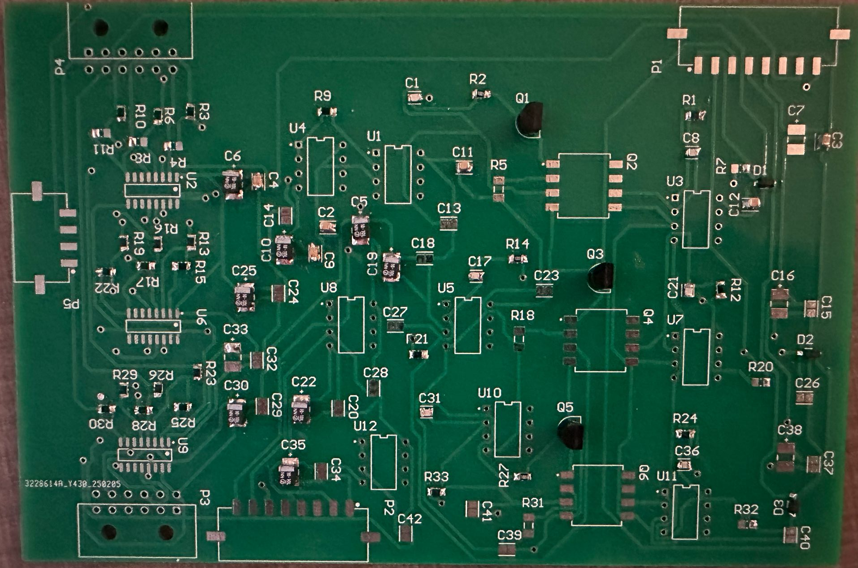
Optoelectronics Mackenzie Miller
New board
Old board had component failure while trying to integrate second time
New board to be operational as soon as parts are delivered
Attempt to retry integration with firmware then MCU
Notes:
Mackenzie
45 seconds
Interesting figure related to your subsystem progress ---
Best to show: Results from prep for integration => integration => test of integrated subsystems

Slide 7
Microcontroller
Andrew Nguyen
Accomplishments since last update 27 hrs of effort | Ongoing progress/problems and plans until the next presentation
Received PCB board Ordered necessary parts Partially assembled board | Finish assembling the rest of the board once final parts come in. Test AC/DC converter and buck converter Begin integrating with firmware code and optoelectronics
Notes:
Drew
45 seconds
What has been accomplished since last review (not just started)
What are you going to accomplish in the next 2 weeks
For 2nd review should all be in the context of your integration plans! For example:
“Completed X-function in preparation for integrating with Y-subsystem”
“Tested integrated motor controllers with MCU by verifying full range of motion on all 6 joints with no load and 0.5kg load”
“On-going integration of motor control system with MCU”
“By next review will integrate with android app”

Slide 8
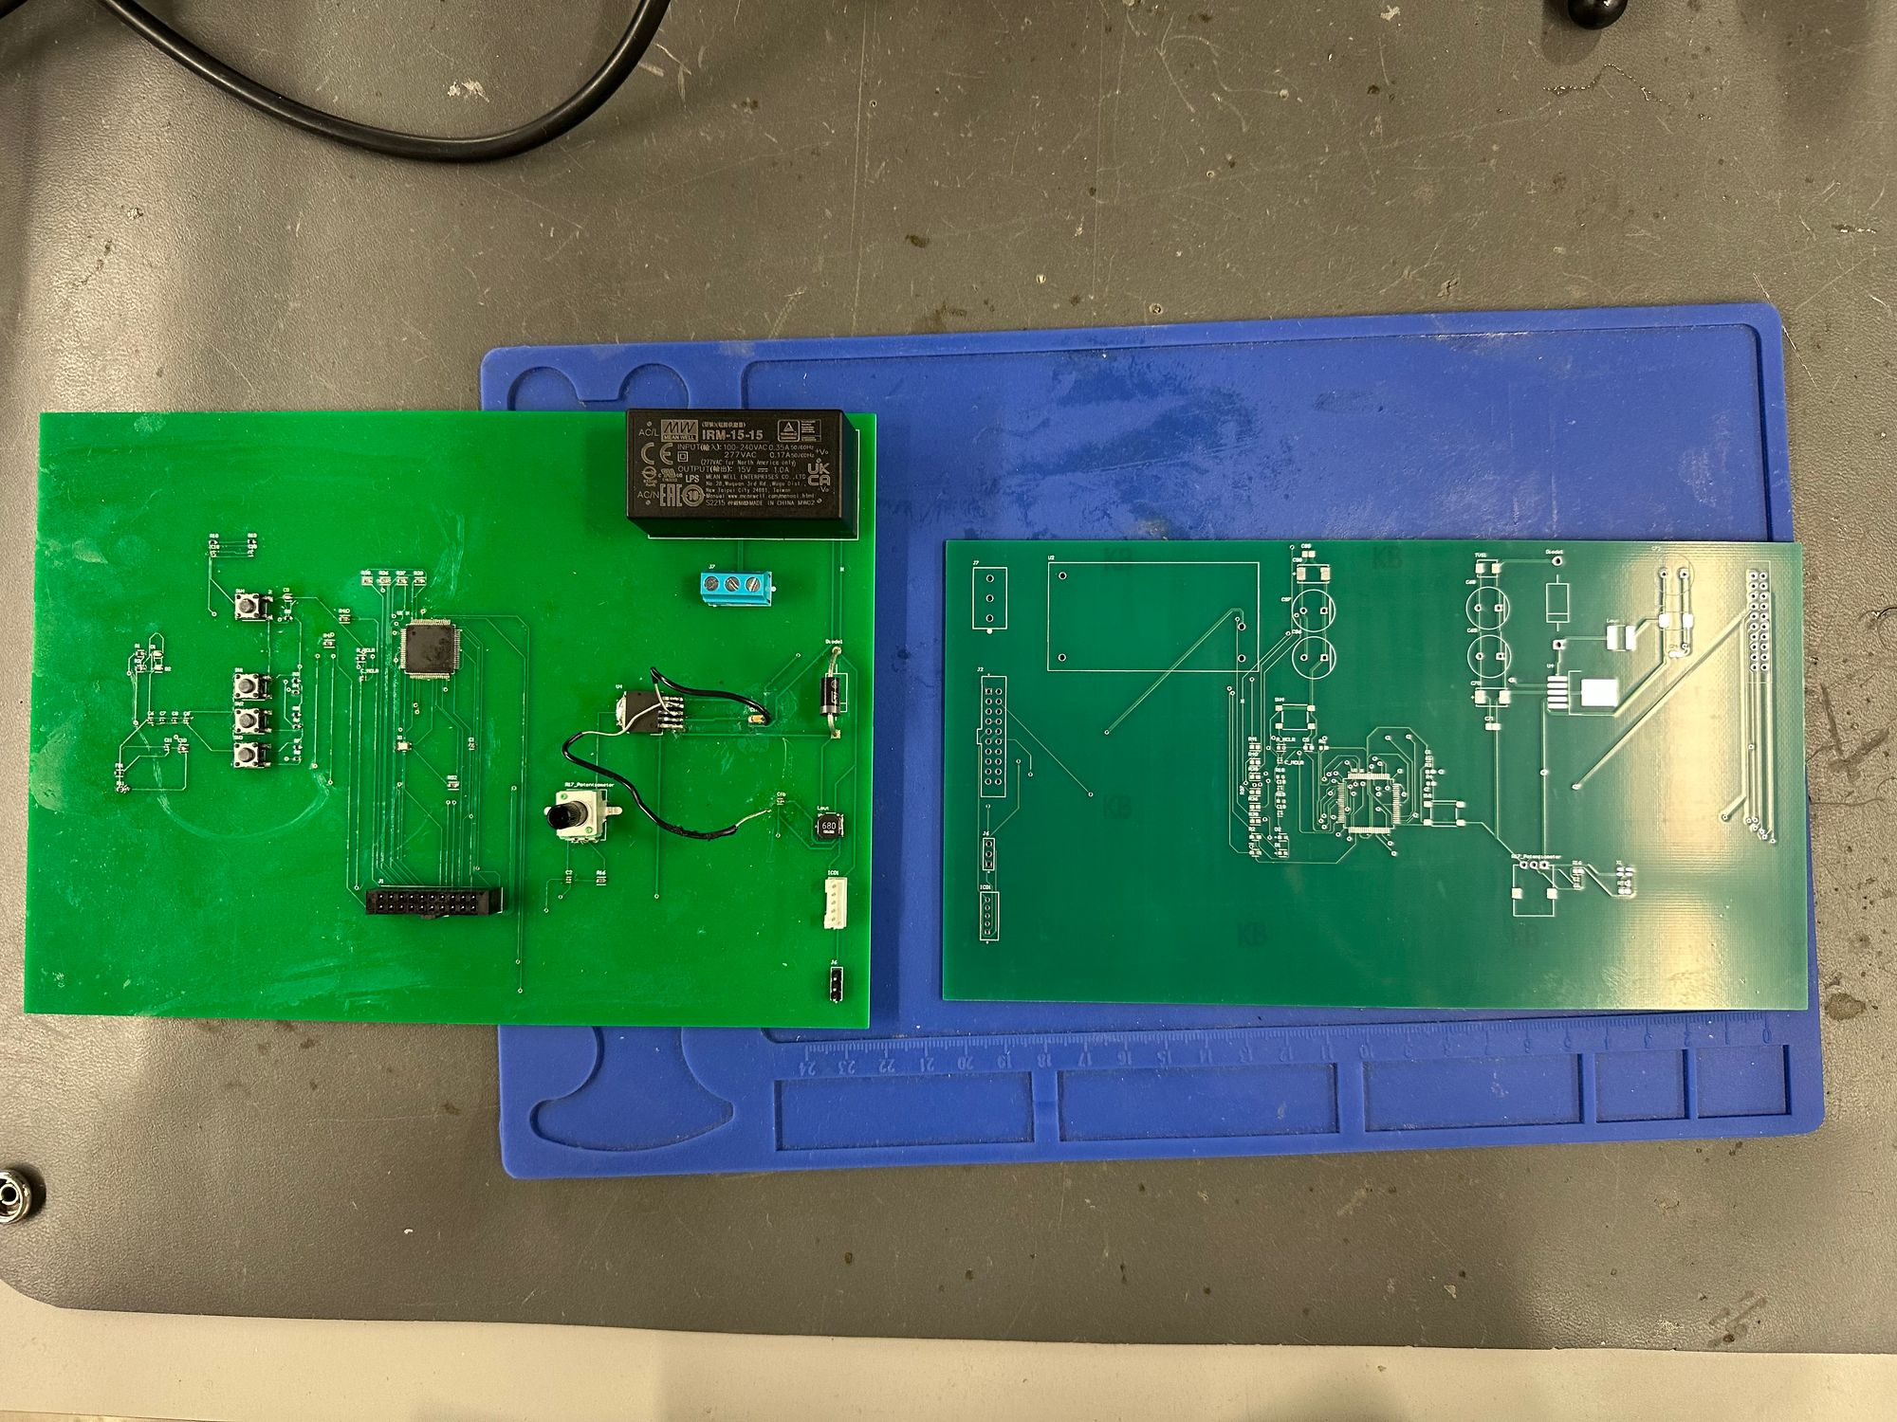
Microcontroller Andrew Nguyen
Made board more compact
Added capacitors to buck converter and AC/DC power supply
Redesigned buck converter
Notes:
Drew
45 seconds
Interesting figure related to your subsystem progress ---
Best to show: Results from prep for integration => integration => test of integrated subsystems

Slide 9
Power
Aidan Rader
Accomplishments since last update 33 hrs of effort | Ongoing progress/problems and plans until the next presentation
Routed PCBv1 Ordered PCBv1 Ordered Parts Order 4 Assembling PCBv1 towards Auxiliary Power Integration | Integrating Auxiliary Power with Microcontroller Assembling entire PCBv1 (sprained thumb) Integrate Auxiliary Power with Optoelectronics Integrate PWM Control Integrate Relay Control
Notes:
Aidan
45 seconds
What has been accomplished since last review (not just started)
What are you going to accomplish in the next 2 weeks
For 2nd review should all be in the context of your integration plans! For example:
“Completed X-function in preparation for integrating with Y-subsystem”
“Tested integrated motor controllers with MCU by verifying full range of motion on all 6 joints with no load and 0.5kg load”
“On-going integration of motor control system with MCU”
“By next review will integrate with android app”

Slide 10
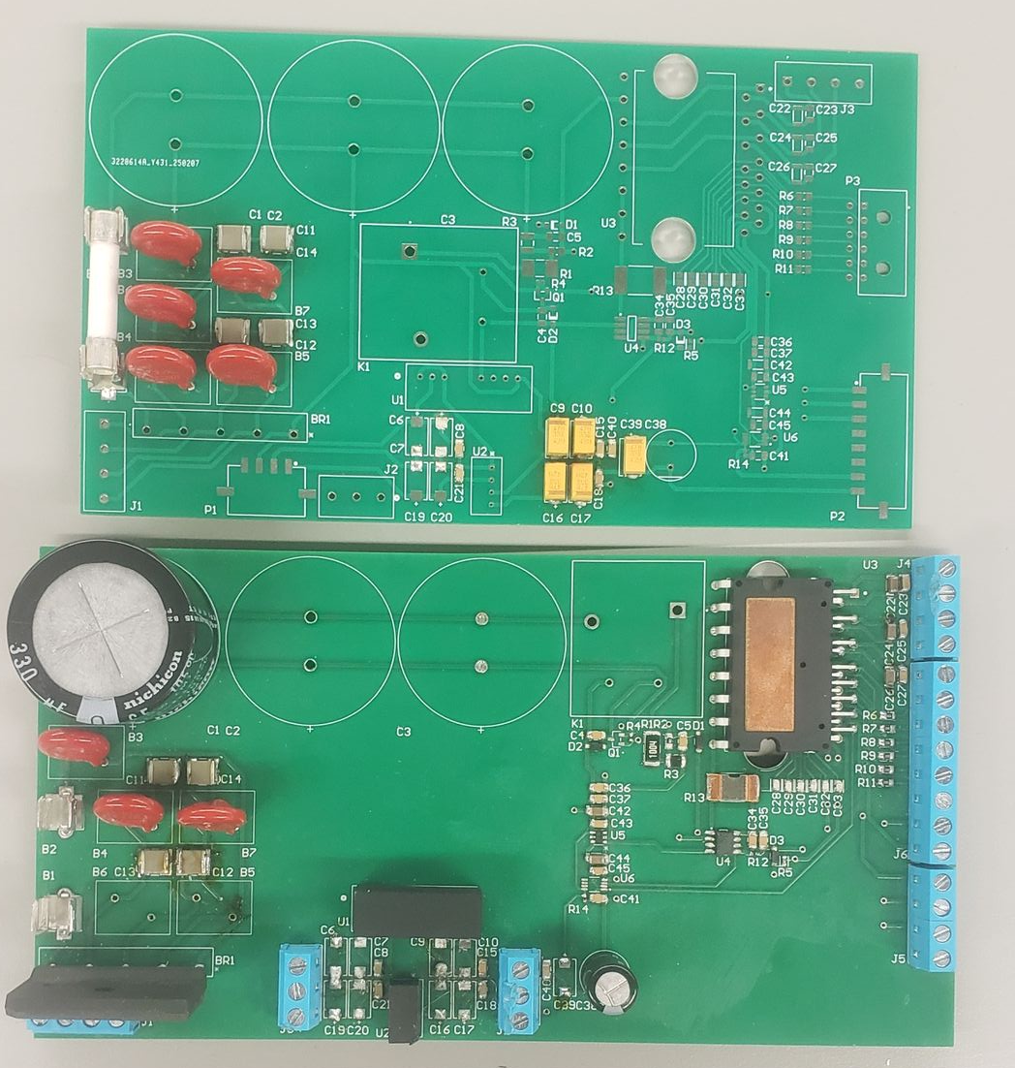
Power Aidan Rader
PCBv1 improvements
Increased board density
Changed screw connectors to ribbon
Aligned connectors to system's physical orientation
Added missing 2 pin connector for 2 phase to 15V Converter
Added missing 3.3V to iso5V converter pin
Rectifier, DC link, 15V to iso15V converter work
Relay is waiting on parts order 4
Power control is waiting on parts order 4
Notes:
Aidan
45 seconds
Interesting figure related to your subsystem progress ---
Best to show: Results from prep for integration => integration => test of integrated subsystems

Slide 11
Firmware
Ryan Regan
Accomplishments since last update 30 hrs of effort | Ongoing progress/problems and plans until the next presentation
Produced Different types of sine waves with oscilloscope Researched usage of PICKIT debugger to program/integrate with microcontroller subsystem Powered the programmed dev board with voltage source instead of direct connection to laptop (for integration with optoelectronics subsystem) Basic integration with Optoelectronics subsystem; PWM signal communication (needs debugging) | Further research the PICKIT debugger to ensure quick integration with microcontroller subsystem Continue integration with Optoelectronics subsystem when new PCB/components arrive Begin power subsystem integration and use it's output to further tune firmware's output frequencies
Notes:
Ryan
45 seconds
What has been accomplished since last review (not just started)
What are you going to accomplish in the next 2 weeks
For 2nd review should all be in the context of your integration plans! For example:
“Completed X-function in preparation for integrating with Y-subsystem”
“Tested integrated motor controllers with MCU by verifying full range of motion on all 6 joints with no load and 0.5kg load”
“On-going integration of motor control system with MCU”
“By next review will integrate with android app”

Slide 12
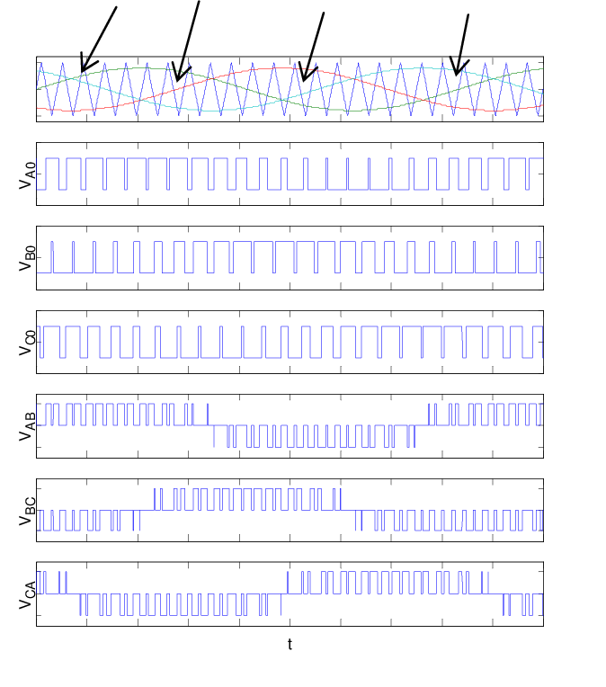
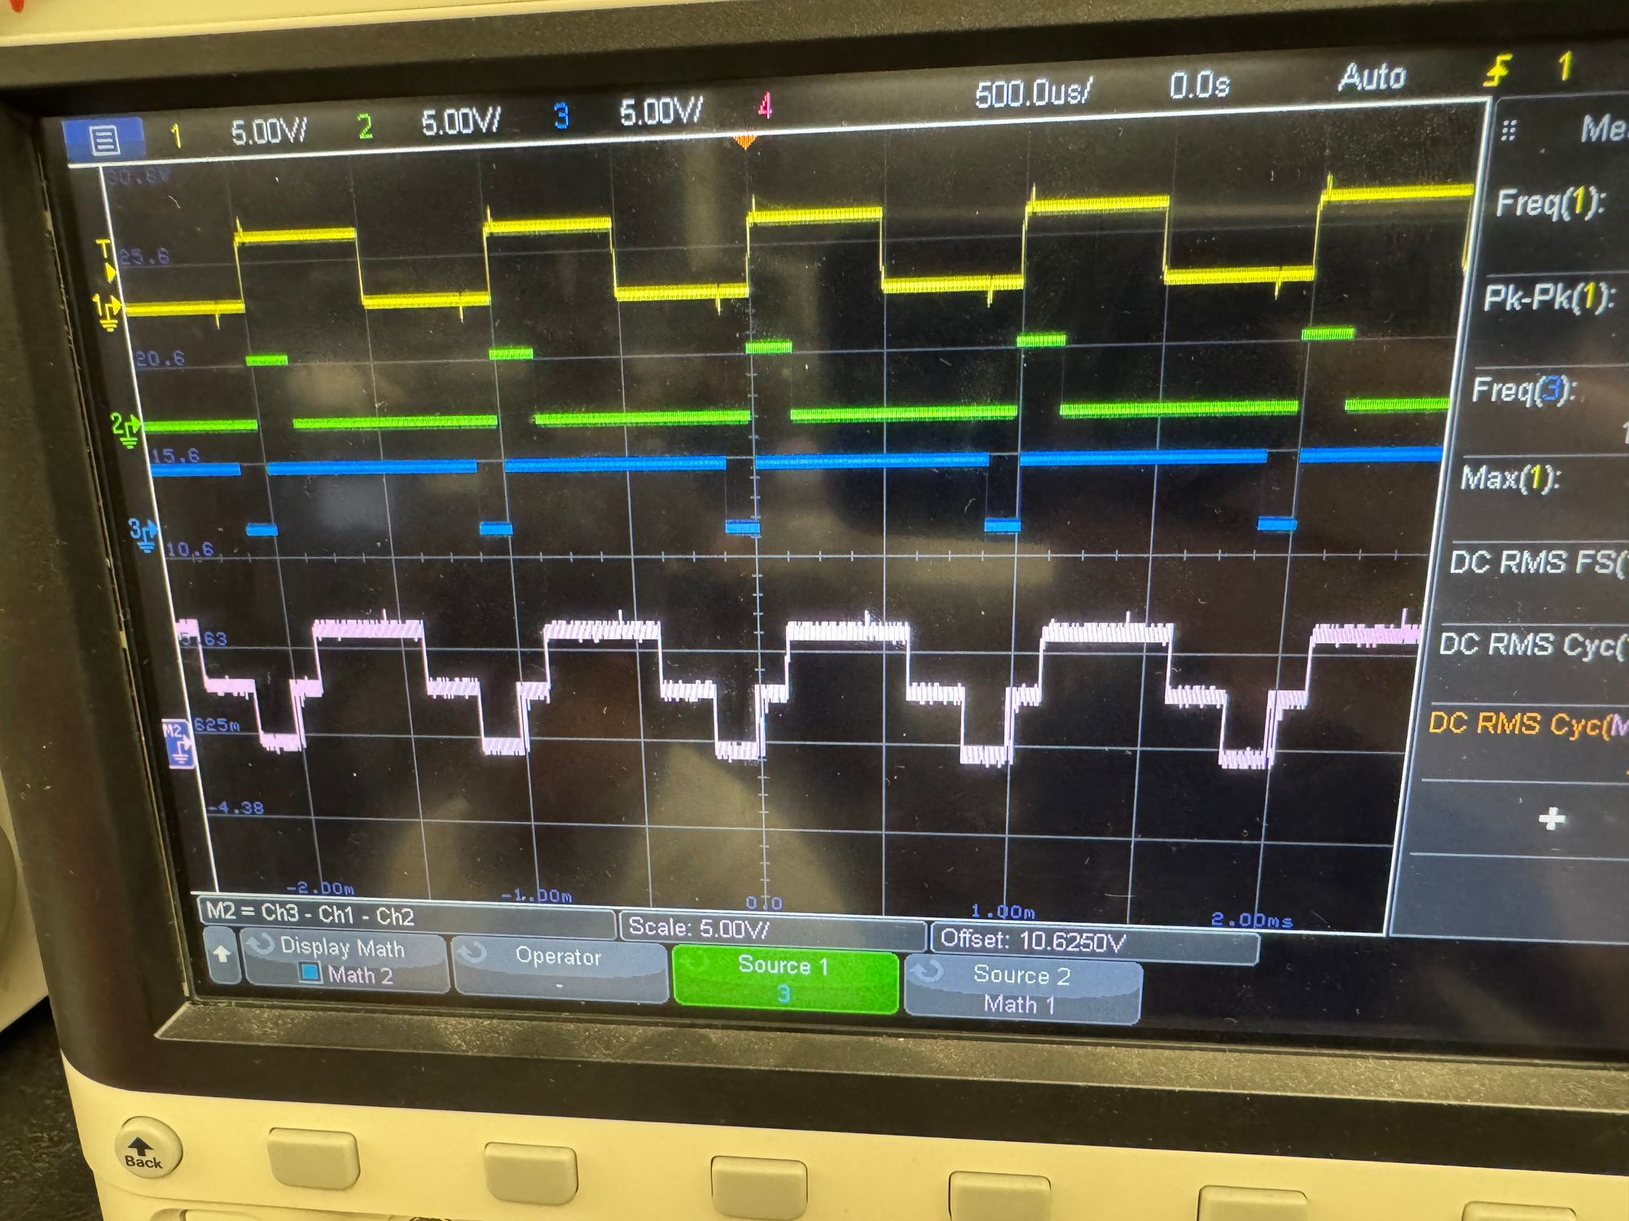
Firmware Ryan Regan
A
B
C
(A-B)
C-(B–A)
(B-C)
(C-A)
Notes:
Mackenzie
45 seconds
Interesting figure related to your subsystem progress ---
Best to show: Results from prep for integration => integration => test of integrated subsystems

Slide 13
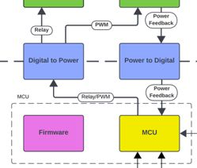
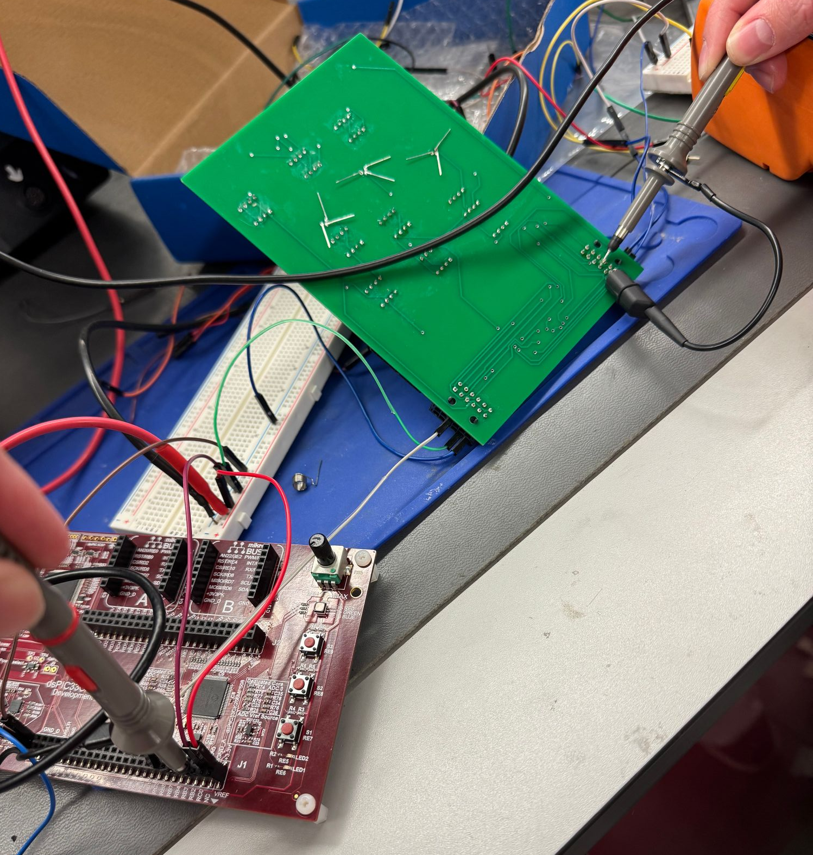
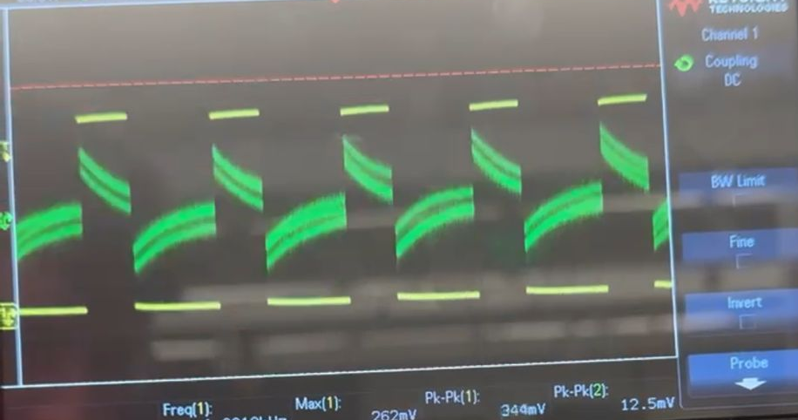

PWM Signal Integration Mackenzie Miller & Ryan Regan
Optoelectronics and Firmware:
Firmware sent PWM waves using dev board to Optoelectronics PCB
Output similar to input
Magnitude and noise of output did not match
Potentiometer was still able to effect output signal's frequency
Dev Board
INPUT
OUTPUT

Slide 14
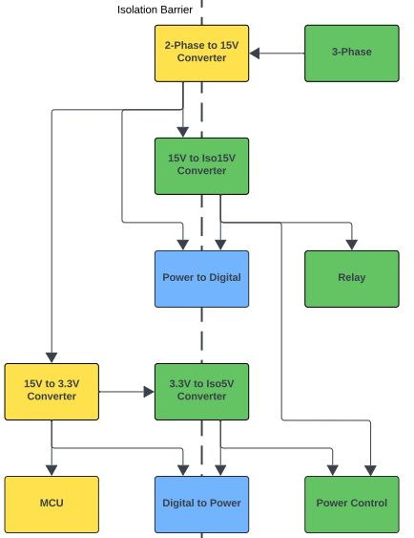
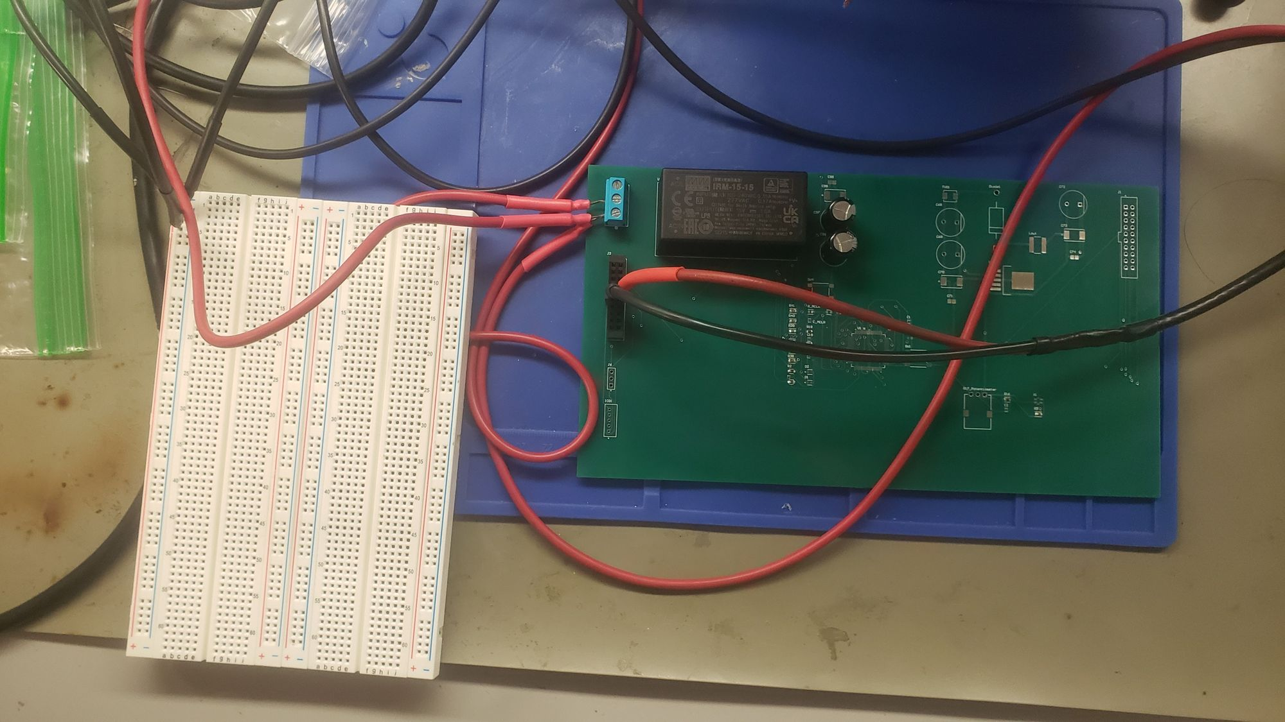
Auxiliary Power Integration Andrew Nguyen & Aidan Rader
MCU and Power:
Assembling these components first
Testing 2-Phase to 15V Converter
Simulating 2-phase with oscilloscope and function generator
Testing 15V to Iso15V Converter
Simulating 15 with dc power supply

Slide 15
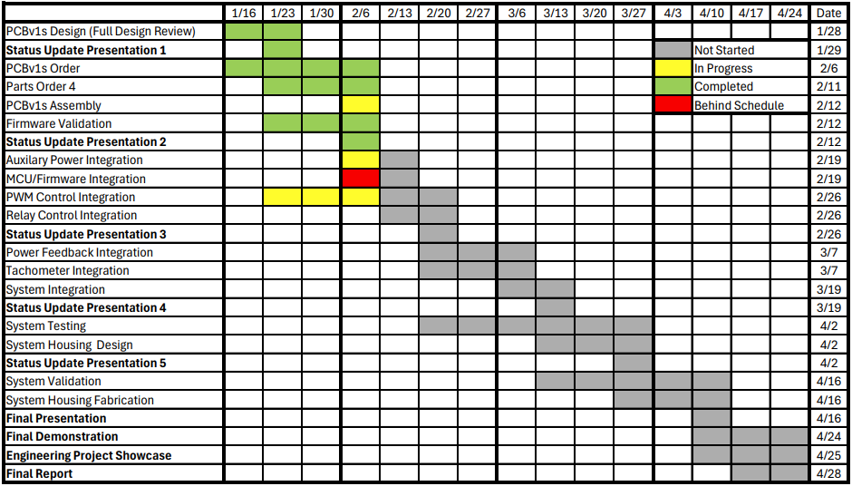
Execution Plan
Notes:
Aidan
30 seconds
Execution plan
-Your team planned milestones for completion of any remaining subsystem functionality, integration of specific subsystems, test, and validation plans should be presented.
-Milestones should have owners … things like final integration can be group owned
-Gantt chart – should indicate some 404 progress.

Slide 16
Validation Plan
Paragraph # | Test Name | Success Criteria | Methodology | Status | Responsible Engineer(s)
3.2.1.1 | Speed and Torque Requirement | Motor shall operate within speed range of 0RPM to 1800RPM and torque range of 0lb-ft to 0.729lb-ft. | Input motor with voltage and check if it achieves 0RPM and 0lb-ft . Repeat for 300RPM, 600RPM, 900RPM, 1200RPM, 1500RPM, 1800RPM. | Untested | Andrew, Ryan
3.2.1.2 | Frequency Requirement | System shall operate within frequency range of 5Hz to 60Hz. | Input system with frequency generator set to 5Hz and check if the motor runs smoothly. Repeat for 10Hz, 20Hz, 30Hz, 40Hz, 50Hz, 60Hz. | Untested | All
3.2.1.3 | Temperature Requirement | System shall operate within temperature range of 0˚C to 70˚C. | Place system in freezer set to 0˚C and check if the motor runs smoothly. Repeat with oven set to 70˚C. | Untested | All
3.2.3.2 | Input Voltage Level | System input voltage shall be 208V_{AC}. | Measure with multimeter and check if the voltage is 208V_{AC}. | Untested | Aidan
3.2.3.3 | Input Noise and Ripple | System shall not exceed ripple range of 0V to 0.165V. | Measure with multimeter and check if the voltage exceeds 0V to 0.165V. | Untested | Andrew
3.2.3.4 | External Commands | External commands shall be documented in appropriate ICD. | Show to teaching team and check with them for approval. | Untested | All
3.2.3.5 | Visual Output | Oscilloscope displays each of the three phases of the PWM sine wave. | Connect oscilloscope probes to the set output pins for the PWM signals, ensure that the signals' duty cycles span from 0-100% and are rougly separated by thirds. | Tested | Ryan
3.2.3.6 | Connectors | System shall use terminal blocks for power and signal connections. | Observe power and signal connections and check if they are are terminal blocks. | Untested | Mackenzie, Andrew, Aidan
3.2.3.7 | Overtemperature Shutdown | System shall automatically shut down if sensor exceeds temperature range of 0˚C to 70˚C. | Place sensor in freezer set to -1˚C and check if sensor is triggered. Repeat with oven set to 71˚C. | Untested | Mackenzie
3.2.3.8 | Built in Test | System shall generate and evaluate test signals to assess failure status. | Compare generated values with known values and check if the failure statuses match. Repeat for six additional sets of values. | Untested | All
3.2.3.9 | Optoelectronics Voltage Constraint | The optoelectronics subsystem shall convert the voltage it receives down to a voltage in the range of 15-20 V. | Test at full power where the opto receives ~60 V. Use a multimeter to measure voltage level on other side of opto barrier. | Untested | Mackenzie
3.2.3.10 | Digital to Power Continuity | The digital to power opto-isolators shall have a voltage of 0V across each component when connecting input to output. | Use a multimeter to ensure that the voltage across each digital isolator is zero. | Tested-retest with new parts | Mackenzie
Notes:
Aidan
30 seconds
Execution plan
-Your team planned milestones for completion of any remaining subsystem functionality, integration of specific subsystems, test, and validation plans should be presented.
-Milestones should have owners … things like final integration can be group owned
-Gantt chart – should indicate some 404 progress.

Slide 17
Validation Plan
Paragraph # | Test Name | Success Criteria | Methodology | Status | Responsible Engineer(s)
3.2.3.11 | Power to Digital Continuity | The power to digital opto-isolators shall have a voltage of 0V across each component when connecting input to output | Use a multimeter to ensure that the voltage across each power isolator is zero. | Tested-retest with new parts | Mackenzie
TBD | Inputs | The parameters are within the expected range. | Confirm that all electrical parameters (voltage, current, power) remain within safe and expected ranges under varying conditions. | Untested | All
TBD | Firmware Code Compiles | MPLab firmware successfully compiles without errors or warnings | Attempt to compile code in MPLab and examine output logs to check for errors or warnings | Tested | Ryan
TBD | Controller Performance | Motor spins according to user defined parameters. | Validate that the system operates efficiently and delivers accurate motor control across the expected range of operating conditions. | Untested | All
TBD | MCU Voltage Step Down | MCU converts the voltage it is given to 3.3V. | Measure the voltage of the signals being sent to the MCU and measure that the MCU converts it to 3.3V. | Untested | Mackenzie, Andrew
TBD | Rectifier Full System | System input voltage shall be rectified from 208V_{AC} to 295V_{DC}. | Measure with multimeter and check if the voltage after the rectifier is 295V_{DC}. | Untested | Aidan
TBD | Rectifier Power Subsystem | System input voltage shall be rectified from 5V_{AC} to 7.1 V_{DC}. | Input 5V_{AC} at differing angles of 120˚ on three waveform generators. Measure with multimeter and check if the voltage after the rectifier is 7.1 V_{DC}. | Tested | Aidan
TBD | Isolated 15V Conversion | System shall convert 15V_{DC} to isolated 15V_{DC}. | Input 15V_{DC} on a dc power supply. Measure with multimeter and check if the voltage after the converter is 15V_{DC}. | Tested | Aidan
TBD | Isolated 5V Conversion | System shall convert 3.3V_{DC} to isolated 5V_{DC}. | Input 3.3V_{DC} on a dc power supply. Measure with multimeter and check if the voltage after the converter is 5V_{DC}. | Untested | Aidan
TBD | User Interface | User is able to change the speed of the rotating PWM values by turning the potentiometer. | Change potentiometer position to lowest, highest, and middle notch to observe that the target frequency of the system is close to 60, 10, and 35 respectively, and the rotating PWM values change pace accordingly | Tested | Ryan
TBD | Frequency Testing | Code properly changes the frequency of the PWM signals | Use oscilloscope or a timer to measure the PWM waves to ensure that the program's target frequency is similar to the actual frequency of the PWM signals. | Untested | Ryan
TBD | Debugger Connection | The Microcontroller shall be able to properly communicate with Pickit4 debugger | Connect the Pickit4 Debugger to microcontroller PCB using the 5 pin connector and ensure that MPLAB X IDE can recognize the device. | Untested | Andrew
Notes:
Aidan
30 seconds
Execution plan
-Your team planned milestones for completion of any remaining subsystem functionality, integration of specific subsystems, test, and validation plans should be presented.
-Milestones should have owners … things like final integration can be group owned
-Gantt chart – should indicate some 404 progress.

Slide 18
Thank you

